Slide 1
ACID BASES AND SALTS Chemical Properties of Acids and Bases
CHAPTER NUMBER 2

Slide 2
Introduction
WHAT ARE:
Acid:
Base
Salts
Notes:
Acid : a substance with particular chemical properties including turning litmus red, neutralizing alkalis, and dissolving some metals; typically, a corrosive or sour-tasting liquid of this kind.
Base : In chemistry, a base is a chemical species that donates electrons, accepts protons, or releases hydroxide (OH-) ions in aqueous solution. Bases display certain characteristic properties that can be used to help identify them. They tend to be slippery to the touch (e.g., soap), can taste bitter, react with acids to form salts, and catalyse certain reactions. Types of bases include Arrhenius base, Bronsted-Lowry base, and Lewis Base.
Salts : any chemical compound formed from the reaction of an acid with a base, with all or part of the hydrogen of the acid replaced by a metal or other cation

Slide 3
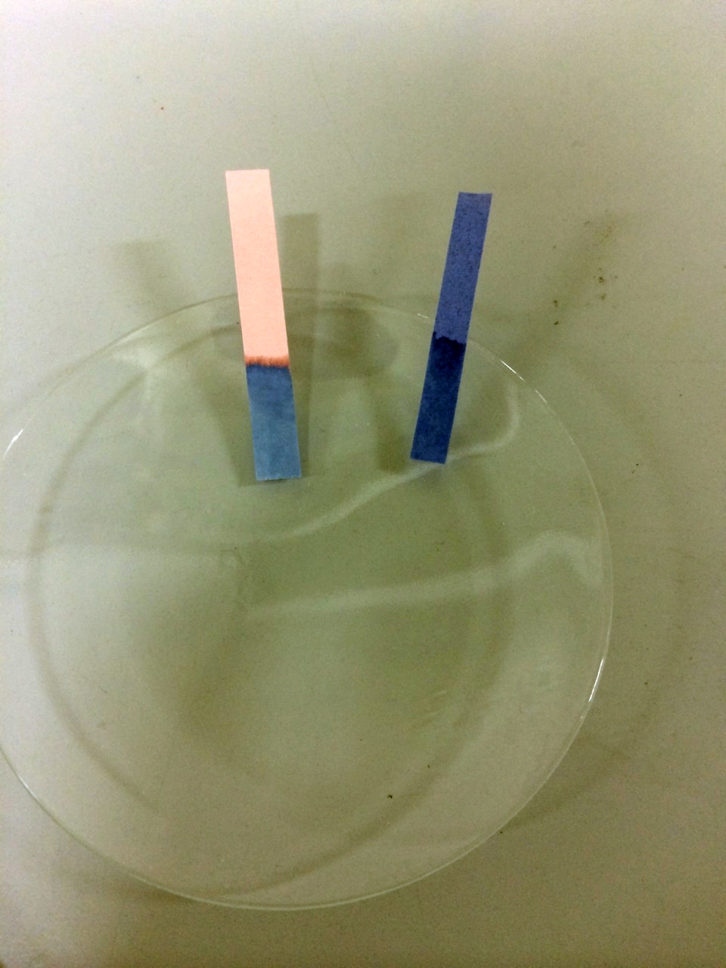
Acids and Bases in the Laboratory
Step 1:Collect the following solutions from the science laboratory–
hydrochloric acid (HCl), ...
Step 2: Put a drop of each of the above solutions on a watch-glass one by one and test with a drop of the indicators Red litmus solution, blue litmus Solution, Methyl Orange, phenolphthalein
Step 3: What change in colour did you observe with red litmus, blue litmus, phenolphthalein and methyl orange solutions for each of the solutions taken?
We observe that these solutions show their acidic and basic behaviour by change in colour.
Notes:
Step 1:Collect the following solutions from the science laboratory–
hydrochloric acid (HCl),
sulphuric acid (H2 SO4 ),
nitric acid (HNO3 ),
acetic acid (CH3COOH),
sodium hydroxide (NaOH),
calcium hydroxide [Ca(OH)2 ],
potassium hydroxide (KOH),
magnesium hydroxide [Mg(OH)2 ], and ammonium hydroxide (NH4OH).
Step 2: Put a drop of each of the above solutions on a watch-glass one by one and test with a drop of the indicators Red litmus solution, blue litmus Solution, Methyl Orange, phenolphthalein
Step 3: What change in colour did you observe with red litmus, blue litmus, phenolphthalein and methyl orange solutions for each of the solutions taken?
We observe that these solutions show their acidic and basic behaviour by change in colour.

Slide 4
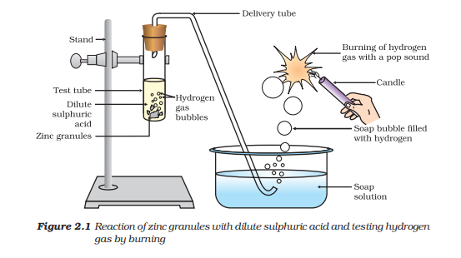
How do Acids and Bases React with Metals?
Notes:
Insert image given in the activity 2.3 in the space provided.
CAUTION: This activity needs the teacher's assistance.
Set the apparatus as shown in Fig. 2.1.
Step 1: Take about 5 mL of dilute sulphuric acid in a test tube and add a few pieces of zinc granules to it.
Step 2:What do you observe on the surface of zinc granules?
Step 3:Pass the gas being evolved through the soap solution.
Observe and Infer: Why are bubbles formed in the soap solution?
Step 4:Take a burning candle near a gas filled bubble.
What do you observe?
Step 5: Repeat this Activity with some more acids like HCl, HNO3 and CH3COOH.
We observe that There are substances whose odour changes in acidic or basic media. These are called olfactory indicators.

Slide 5
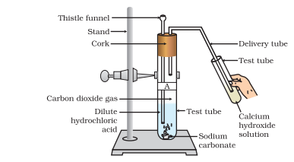
How do Metal Carbonates and Metal Hydrogen carbonates React with Acids?
Notes:
Insert image of activity 2.5 and fig 2.2
Step 1:Take two test tubes, label them as A and B.
Step 2: Take about 0.5 g of sodium carbonate (Na2CO3 ) in test tube A and about 0.5 g of sodium hydrogen carbonate (NaHCO3 ) in test tube B.
Step 3:Add about 2 mL of dilute HCl to both the test tubes.
What do you observe?
Step 4: Pass the gas produced in each case through lime water (calcium hydroxide solution) as shown in Fig. 2.2 and record your observations.
The chemical reactions are:
Test Tube A:Na2Co3+2HCl = 2NaCl+H2O +CO2
Test tube B: NaHCO3 + HCl(aq) = NaCl(aq) H2O(l) + CO2
On passing the carbon dioxide gas evolved through lime water,
Ca(OH)2 + CO2 = CaCO3 + H2O
(Lime water) (White precipitate)
On passing excess carbon dioxide the following reaction takes place:
CaCO3+ H2O(l)+ CO2 (g) → Ca(HCO3)
INFERENCE: Limestone, chalk and marble are different forms of calcium carbonate. All metal carbonates and hydrogen carbonates react with acids to give a corresponding salt, carbon dioxide and water. Thus, the reaction can be summarised as –
Metal carbonate/Metal hydrogen carbonate + Acid → Salt + Carbon dioxide + Water

Slide 6
How do Acids and Bases React with each other?
NaOH(aq)
+
HCL(aq)
NaCl(aq)
+
H₂O(l)
Base
+
Acid
Salt
+
Water
Notes:
Step 1:Take about 2 mL of dilute NaOH solution in a test tube and add two drops of phenolphthalein solution.
Observe the colour of the solution?
Step 2: Add dilute HCl solution to the above solution drop by drop.
Observe if there are any colour change for the reaction mixture?
Also infer why did the colour of phenolphthalein change after the addition of an acid?
Step 3:Now add a few drops of NaOH to the above mixture.
Observe if the pink colour of phenolphthalein reappear?
Why do you think this has happened?
In the above Activity, we have observed that the effect of a base is nullified by an acid and vice-versa.
The reaction taking place is written as – NaOH(aq) + HCl(aq) → NaCl(aq) + H2O(l)
The reaction between an acid and a base to give a salt and water is known as a neutralisation reaction.
In general, a neutralisation reaction can be written as –
Base + Acid → Salt + Water

Slide 7
Reaction of Metallic Oxides with Acids
Calcium hydroxide, which is a base, reacts with carbon dioxide to produce a salt and water.
Nonmetallic oxides are acidic in nature.
Metal Oxide
+
Acid
Salt
+
Water
Reaction of a Non-metallic Oxide with Base
Notes:
Step 1:Take small amount of copper oxide in a beaker and add dilute hydrochloric acid slowly while stirring.
Step 2:Note the colour of the solution. What has happened to the copper oxide? You will notice that the colour of the solution becomes blue-green and the copper oxide dissolves. The blue-green colour of the solution is due to the formation of copper(II) chloride in the reaction.
The general reaction between a metal oxide and an acid can be written as – Metal oxide + Acid → Salt + Water Metal.
For Non Metallic Oxides
You saw the reaction between carbon dioxide and calcium hydroxide (lime water) in Activity 2.5. Calcium hydroxide, which is a base, reacts with carbon dioxide to produce a salt and water. Since this is similar to the reaction between a base and an acid, we can conclude that non-metallic oxides are acidic in nature

Slide 8
CONCLUSION
In this part we learnt about:
Acids and Bases in the Laboratory
How do Acids and Bases React with Metals?
How do Metal Carbonates and Metal Hydrogen carbonates React with Acids?
How do Acids and Bases React with each other?
Reaction of Metallic Oxides with Acids
Notes:
In this part we learnt about:
Acids and Bases in the Laboratory
How do Acids and Bases React with Metals?
How do Metal Carbonates and Metal Hydrogen carbonates React with Acids?
How do Acids and Bases React with each other?
Reaction of Metallic Oxides with Acids

